Slide 1

Prenatal Down Syndrome Risk Detection
Aasiya M
Under the Supervision of
Prof. Natheera Beevi M
TKM College of Engineering, Kollam
September 25, 2025

Slide 2
Presentation Outline
2
Introduction
Problem Description
Existing System
Problem Statement and Objectives
Literature Review
Methodology
Data Flow Diagram
Project Progress and Pending Works
Results and Screenshots

Slide 3
Introduction

Slide 4
Problem Description
4
Prenatal screening is critical for detecting fetal anomalies early.
NT thickness is a key indicator for detecting Down Syndrome.
Manual measurement is time-consuming, subjective and prone to human error
Lack of an automated, reliable system for NT detection, measurement, and risk classification.

Slide 5
Existing System
5
Traditional ultrasound interpretation relies on manual NT measurement by radiologists.
It is subjective as it is prone to human error and observer variability.
Requires high expertise and experience for accuracy.
Time consuming

Slide 6
Problem Statement and Objectives
6
Problem Statement :
Development of an automated pipeline for Down Syndrome risk assessment from first trimester ultrasound images using deep learning.
Objectives :
Preprocessing: Normalize prenatal ultrasound images.
Segmentation: Apply U-Net to find and segment the NT region.
Classification: Apply CNN to classify scans as standard or non-standard.
Risk Assessment: Use extracted NT features for Down Syndrome risk prediction.
Visualization: Highlight segmented NT region and display risk outcom

Slide 7
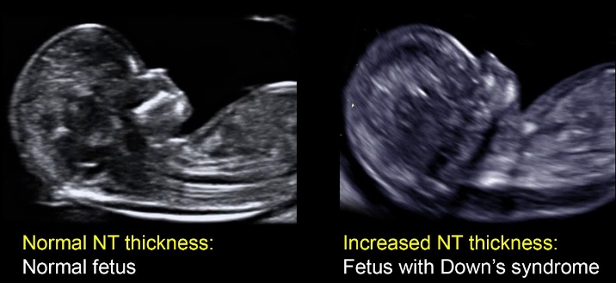
Sample NT Scan

Slide 8
Literature Review

Slide 9
Literature Review
8
Author
Contribution
Limitations
Methods Used
Verma et al. (2022)
Classified abnormal vs normal risk in fetal NT scans
Focused only on classification; small dataset; no segmentation or measurement
Adaptive SGD with NT features; evaluated using accuracy, precision, recall
Oza et al. (2021)
Automated NT segmentation and thickness measurement
Relied on hand-crafted features; less accurate and robust than deep learning
SIFT keypoints + GRNN model
Thomas et al. (2024)
Compared segmentation approaches for NT measurement
Traditional methods struggled with noisy ultrasound; no classification or risk assessment
Edge detection, Active Contour, Chan-Vese algorithms

Slide 10
Methodology

Slide 11
Methodology
11
System Architecture: A deep learning framework built in two phases: CNN classifier to determine whether the scan is a standard sagittal view or non-standard, followed by U-Net to accurately segment NT region.
Data Preprocessing: NT scan normalization, data augmentation to improve model performance.
Model Development:
CNN classifier (ResNet18) for binary classification (standard / non-standard sagittal NT scans).
U-Net to accurately segment the NT region.
NT Thickness Measurement
Risk Assessment : rule based. If thickness greater than 3mm -> high risk, else low risk.

Slide 12
Methodology
12
Training Framework:TensorFlow/Keras implementation with Adam optimizer, binary cross-entropy and Dice coefficient losses, optional learning rate scheduling, and GPU acceleration for efficient processing.
Evaluation Metrics: Dice coefficient for segmentation accuracy, and precision/recall/F1-score for classification performance.

Slide 13
Architectural Diagram
Preprocessing
CNN
Input Scan
Resizing
Image Classification
Augmentation
NT Thickness Measurement
Normalization
Tensor Conversion
U-Net
Rule based Classification
NT Segmentation
Result with Visualization

Slide 14
Results and Screenshots

Slide 15
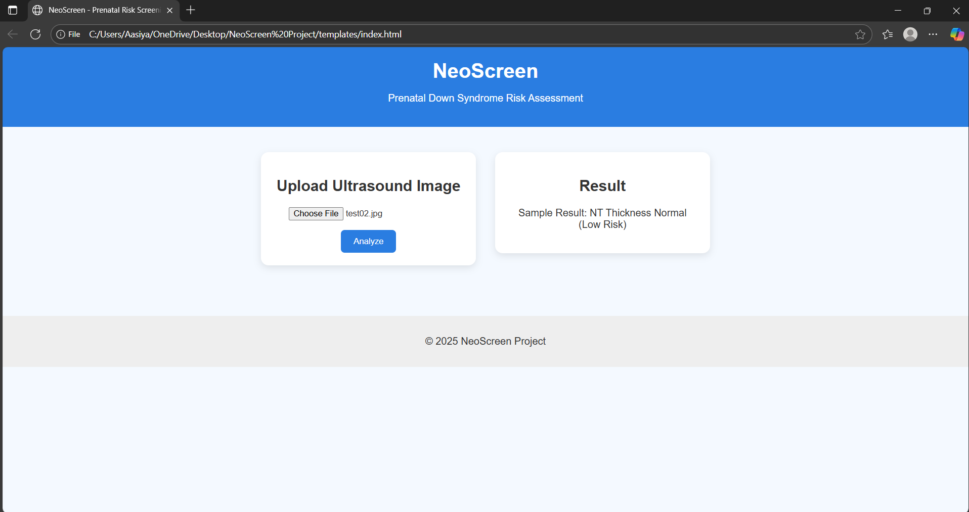

Slide 16
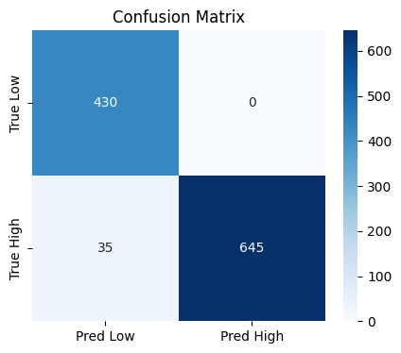
Classification Metrics:
Accuracy: 97%
Low Risk: Precision = 0.92, Recall = 1.00
High Risk: Precision = 1.00, Recall = 0.95
F1-Score: 0.97 (97%)

Slide 17
Thank You

